Slide 1
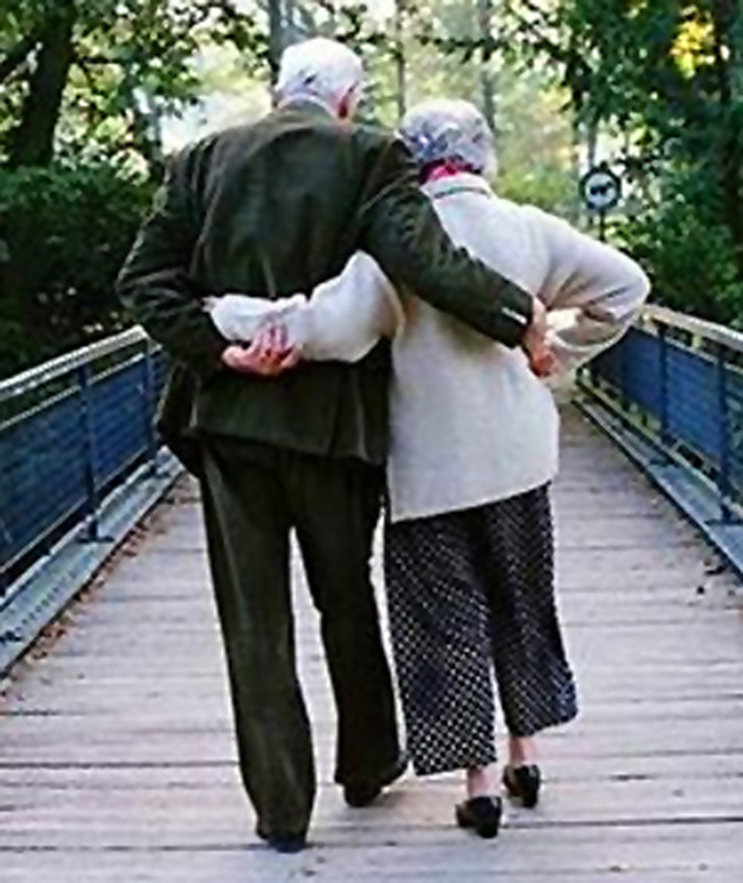
Married: Growing & Serving Together
Marriage is Made in Heaven – Part 2
A Study of Marriage, Spring 2023

Slide 2
“Leave,” “Cleave,” and “Become One Flesh” (Moses’ Inspired Commentary in Gen. 2:24)
“For this reason, a man shall leave his father and his mother and be joined to his wife; and they shall become one flesh.”
For what reason?
Because man needs his flesh (rib) back! ☺
Because they came from one flesh, they shall be joined as one flesh.
Jesus used this truth to show it is sin to separate what God had joined
The leaving and joining (cleaving) show commitment and permanence
Leaving means I’m committed to my spouse first and foremost
I’m severing the parent/child bond in favor or a new bond
Leaving involves thinking & emotions more than physical relocation
Cleave/join means “to make a binding covenant or contract; to grab or hold with firmness”
Like Superglue – perm. bond; separation will damage the two parts
The bond makes the two parts into one – “one flesh”
What are some applications we
can make from Leave & Cleave”?
“So, they are no longer two, but one flesh.” Matt. 19:6a
Notes:
Mt. 19:4a-5a “He who created them...and said...”
The Greek philosopher Plato stated that mankind became too powerful in the past and the gods split them in half. “Now, since their natural form had been cut in two, each one longed for its own other half..And now ‘love’ is the name for our pursuit of wholeness.”

Slide 3
Applying the Charge to Leave and Cleave
First, parents of newlyweds need to help, not hinder this process.
In some patriarchal cultures, pleasing family is given first importance.
Certainly, “going home to mama” at the first sign of trouble is not consistent with the charge to leave parents and unite with our spouse.
Look inward when you have disagreements about issues like spending money, discipline of children, or even vacations. Are you advocating a position because “my family did it that way?” Maybe the opposite?
You have forged a new union, and your spouse must feel that they and your marriage are your first priority after God (not parents, children, close friends, career, hobbies, or even service to others).
It is a process; the identity of the new family unit doesn’t develop overnight.
“Marriage is two becoming one, and the whole time you are trying to figure out which one you are becoming!” – Brent Hunter
What is Meant by “Become One Flesh”?
Notes:
How your family did things should be neither the positive way to proceed or something to be repudiated (if you have some negative baggage from childhood). Together, you and your spouse are a new decision-making unit.

Slide 4
“Become One Flesh”
Gen. 2:24: “For this reason, a man shall leave his father and his mother and be joined to his wife; and they shall become one flesh.”
(Repeated in Mt. 19:5, Mark 10:8, Eph. 5:31, and 1 Cor. 6:16)
Becoming one flesh refers to the sexual union on one level (1 Cor. 6:16) “Do you not know that he who unites himself with a prostitute is one with her in body? For it is said, “The two will become one flesh.”
The oneness in marriage is to be much more than just sexual union, it is the personal union of a man and woman at all levels of their lives.
“One flesh” means they are united in every way as a single whole -- intellectually, emotionally, and spiritually as well as physically.
This unity requires work to blend the wills of both parties.
Spouses should not need outside pursuits to engage their whole selves.
“It affirms that just as blood relations are one’s flesh and bone, so marriage creates a similar kinship relation between man and wife. They become related to each other as brother and sister are.” – Gordon Wenham, Genesis Commentary
Notes:
“Flesh” is a synecdoche, a figure of speech in which a part of a thing is used to represent the whole (as in our phrase “counting noses”). Acc. To Joel 2:28, God would pour out his spirit on “all flesh”. This did not mean that God was giving his spirit to all bodies. Rather, he was giving his Spirit to all people.
If you seek outside things to really find joy and meaning and fulfillment, that will be deadly. Your spouse will sense they are not the most important thing in your life.

Slide 5
What Should “One Flesh” Look Like?
(Two People Can Exist Together in a Variety of Ways)
Not
Engaged
Active
Engagement
(Can be productive or unproductive)
The Ideal
(In God’s Image, distinct personalities that are inseparably united, completed by the other)
One Dominates & One Surrenders
OR

Slide 6
Which Is God’s Plan?
This?
This?
OR
Homosexual relationships are sinful without question.
But so is the denial of innate, created differences between men and women. These differences are our gifts from God.
Women should not seek to develop a dominant, swaggering (and sinful) male-like behavior in an effort to get ahead or be taken seriously. And, among other things, men cannot abdicate their charge to be godly leaders of their families.

